Slide 1


St Louis Catholic Life
Our Community Involvement
An overview of some of the many groups that we support and that work to support our school
As a Catholic School, we recognise that our community involvement forms part of our commitment to living out our Gospel Values

Slide 2
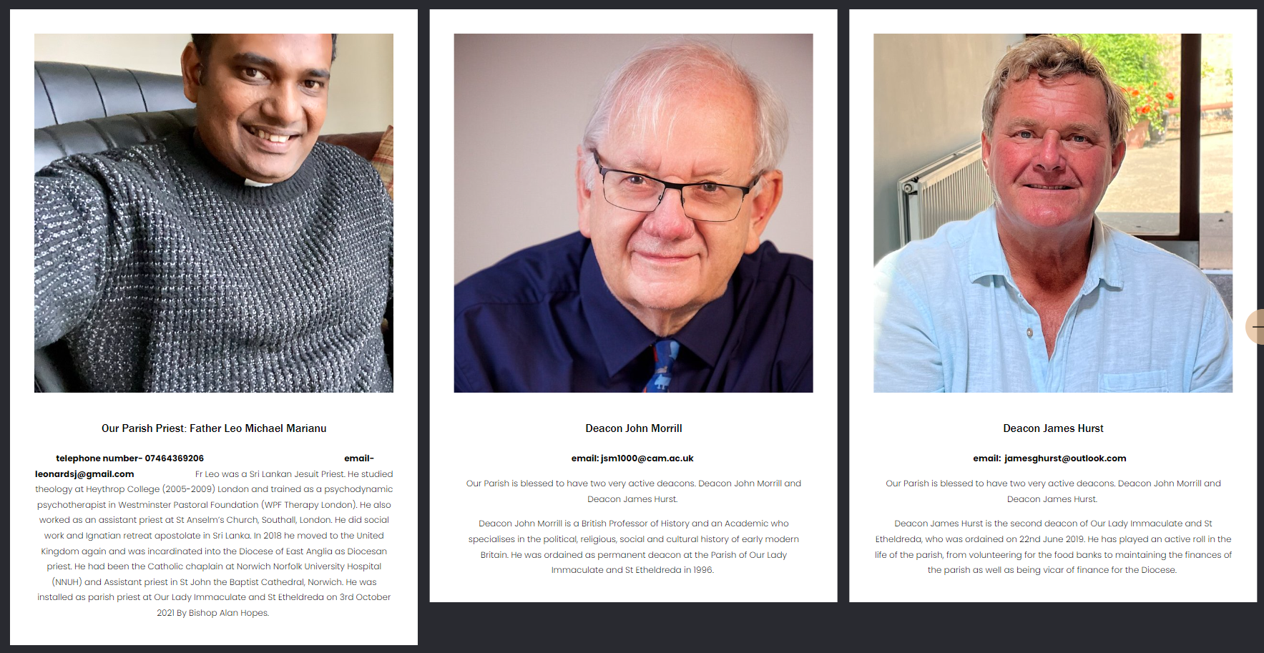

Our Lady Immaculate & St Etheldreda Newmarket
Our Community Parish
School is supported by Fr. Leo, Fr. John, Deacon James and the parishioners who come into school to work with our children. We regularly visit the church and we are grateful for their support in hosting our Christmas Nativity Plays, Carol Concerts, developing our school Chaplains and praying with us. Fr Leo regularly celebrates Mass with us in church and in school for our children and their families. We welcome the Parish Team to work with children, supporting them in their understanding of our Catholic Faith.

Slide 3

St Louis PTA
The St Louis PTA is the volunteer fundraising group for St Louis Catholic Academy. Over the years, volunteers have raised thousands of pounds which has been spent on improving equipment and resources to enhance our children’s education and the facilities in school in general.
But our PTA is about much, much more than just fund raising. This group bring staff, parents and friends together socially in support for the school, working towards a common goal.
The registered charity abides by the charity commission rules and regulations and are bound by a constitution. In recent years, school has benefited from many gathering including the Advent and Summer Fair, Quiz Nights, Lego Clubs, International Food Festival and Macmillan Coffee Mornings.
School has received funding towards an outdoor gym, fantastic book corners, stocks of new books and a friendship bench.

Slide 4

CAFOD (Catholic Aid for Overseas Development)
St Louis support CAFOD through many fundraising activities and CAFOD local representatives come into school to speak to children about the importance of supporting communities living in poverty and in conflict.
CAFOD is the official Catholic aid agency for England and Wales, and part of Caritas International. The charity works through the local Church to reach people and places that others can’t.
Across the world the charity brings hope and compassion to poor communities, standing side by side with them to end poverty and injustice. The organisation works on long-term development as well as responding to emergencies.
In supporting CAFOD, children increase their understanding of social justice and recognize that each of us working together can bring about positive change.

Slide 5

FAIRTRADE
St Louis is a Fairtrade accredited school. In becoming a Fairtrade School we are part of a worldwide movement – a movement where young people learn that, whatever their age, they have the power to make a difference in the world.
It offers our children a great opportunity to look at global issues such as where our food comes from and how we are connected to people around the world. Students can also learn a range of skills, from teamwork and co-operation to persuasive writing to running a stall or tuck shop.
Teaching about Fairtrade fits different curriculum areas, especially Geography, Citizenship and PSHE. We raise awareness and understanding amongst our children that we have a social responsibility towards others. Fairtrade works with farmers and workers in more than 1,900 producer organisations, across 70 countries, so they can improve their living standards, invest in their communities and businesses, and protect our shared environment.
Some of activities include buying fairly traded goods for use in school, hosting a Fairtrade fundraiser shop annually, involving students in promoting Fairtrade during Fairtrade Fortnight, teaching children about the benefits of fair trading and encouraging local action by our children who lead initiatives.

Slide 6


Mini Vinnies
Parish volunteer, Mrs. Das leads our Yr 4 to 6 group of young volunteers. Mini Vinnies follow in the footsteps of Christ and St Vincent de Paul.
The Mini Vinnies are the youngest members of the St Vincent de Paul Society (SVP), an international Christian voluntary organisation dedicated to tackling poverty in all its forms by providing practical assistance to people in need.
The Mini Vinnies get together in our school with parish support to live out our mission of see, think, do, supporting our school community and beyond alongside the SVP. Our Mini Vinnies are between the ages of eight and eleven. Our Mini Vinnies turn concern into action by…
Praying for those in need
Making cards for those who may be sick, isolated and lonely
Visiting local care homes to sing and share stories with residents
Taking part in arts and crafts to share with others
Preparing food for fundraisers
Supporting other children in our school and parish

Slide 7


Sisters of St Louis
The Sisters’ aim is to help develop right relationships in society by enabling individuals and communities to empower themselves without oppressing others. In this context, we work with migrants, refugees, ex-offenders, women, youth, faith groups, those affected by HIV/Aids, among others. The Sisters identify concerns and agree shared visions, help source funding, develop advocacy skills, and foster social inclusion. They collaborate with other agencies to bring about positive social change. They also actively promote societal and political awareness of needs through lobbying, and supporting research that engages with structural and systemic issues.
Historically, our school was founded by Sisters of St Louis and we maintain our links with this Order. The Sisters are funding a Mental Health Hub, The Sisters of St Louis Nest Mental Health Hub. This space will support children who experience social emotional difficulties. This will be a specially designed nurture space for 1 to 1 and small group therapies and we hope to welcome families

Slide 8
Volunteers
Parents and grandparents often give time in school. This can include , for those with DBS checks, joining us on learning visits,
We benefit from many parents, relatives and friends giving time to speak to children during British Science Week, Vocations Fortnight and Multi-faith Fortnight.
Volunteers help introduce us to benefactors in our area. One such person gifted school £12,000 towards the Mustard Seed Kitchen.
Volunteer Year 6 parents complete fundraisers annually alongside their children to enable them to fund an end od school party, Year Book and Hoodies.
A grandmother knitted the Reception Nativity loan bag.

Slide 9
Toddler Drop In
We invite mums and dads of toddlers to join us at a monthly drop in session at our Acorns Nursery. This is for families of all faiths and none. This group began to support families post Covid when young children had missed out on group socialisation. Mrs Das, our Parish volunteer welcome families to join this group.
It has become a monthly get together for families to brink their pre-school children to play, chat and form friendships. A parishioner leads the drop in and welcomes visitors. The Nursery staff help with activities for the children and this support group helps children to take the next step towards attending a nursery independently.

Slide 10
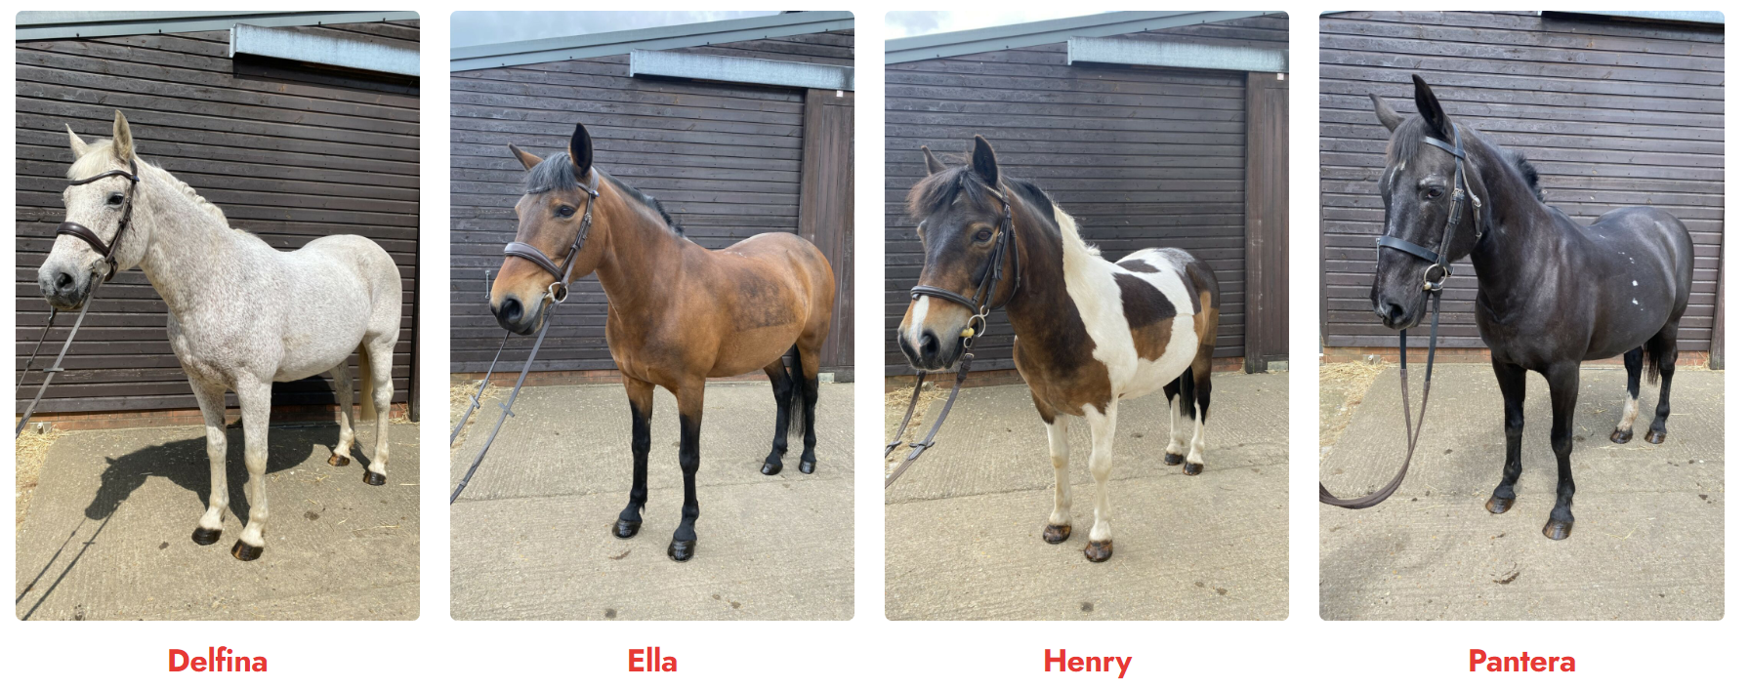
Newmarket Pony Academy
The Newmarket Pony Academy, at the British Racing School, is a community project using horses and ponies to positively effect mental health and wellbeing for the children in Newmarket.
Newmarket, despite being the headquarters of racing, does not offer affordable access to children to learn, ride or look after these animals. These children see horses around Newmarket town and surrounding areas every day and the Newmarket Pony Academy gives them that chance. The Newmarket Pony Academy has been designed to give young people the opportunity learn new skills such as team work, confidence and resilience. They have the chance to learn about the animal and also the hard work and dedication it takes to look after them. They benefit enormously from developing life skills from this unique experience.
The Newmarket Pony Academy is host to a five day primary school program, designed to mix equine care with core subjects and team building activities embedded into this diverse learning experience. The courses build on the curriculum and work on key skills, such as confidence, resilience and overall engagement in learning, through delivering practical and theory lessons to the students.
Further to this, the NPA runs afterschool, weekend and holiday clubs for local young people who have been referred to the project by teachers and social workers. It is hoped that ongoing engagement with the NPA will give these young people a positive constant. We really believe in the social and mental health benefits from this type of learning, and are incredibly excited to empower these young people. St Louis gives time to support the work of the NPA and refers children onto the programme. At least twenty children benefit annually.

Slide 11

Buying Local and All Saints C of E Primary School and Paddocks Primary in Newmarket
Where feasible, we buy locally to support local commerce:
Sausages from Powters in Newmarket
Fruit from the Newmarket market trader
Tesco Newmarket for online deliveries
Simpsons for garden supplies
Mr. Cricket and local supermarkets for school uniform
The school cleaning contractor G Clean is based in Suffolk and his small team live locally too.
Most of our staff who are employed live locally.
St Louis works collaboratively with local schools for mutual benefit and support.
With Paddocks Primary, we:
Moderate our writing,
Share ideas
With All Saints C of E Primary, we :
Share sponsorship for Patrick, supporting his education in Uganda,
Lead prayers for one another’s school assemblies,
Share ideas and provide mutual support,
Invite each other to our schools to share good practice.

Slide 12

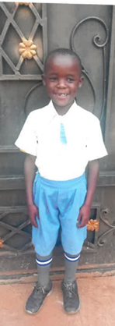
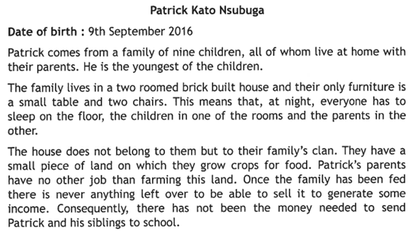
EVC Uganda
This is Patick , a child whom we are sponsoring through school together with All Saints C of E Primary School. Your help has covered his fees for the first year. We raised the money on the day that we wore the colours of Uganda. And sold hot chocolate drinks. Children will be able to write to Patrick and we look forward to hearing about his family and school too. To find out more, please visit: www.evcuganda.org

Slide 13

Under Starters Orders
Under Starters Order Charity help our children gain an understanding of the horse and the horseracing industry. Working in partnership with Newmarket Racecourse, this programme is aimed at Year 5 pupils from Primary Schools in the Newmarket area. It is a three day initiative bringing learning to life with visits to Dalham Hall Stud, National Horseracing Museum, The National Stud and Newmarket Racecourses and is delivered by Racing to School.
Our Year 5 children take part in the visit to the National Horseracing Museum annually. We use this opportunity to explore the history of racing and also to use the day to explore displayed artists.

Slide 14

Racing Welfare
Racing Welfare is a registered charity supporting the workforce of British
horseracing. They offer professional guidance and practical help to the stud, stable and racecourse staff whose dedication is vital for the well-being of racing. Their work aims to help people, from recruitment to retirement, to thrive in day to day life and through a range of life’s challenges.
The Charity provides support to some children and their families in our school.
We support fundraising for Racing Welfare too. Most recently, our school choir performed at Tattersalls at an annual fundraiser.

Slide 15

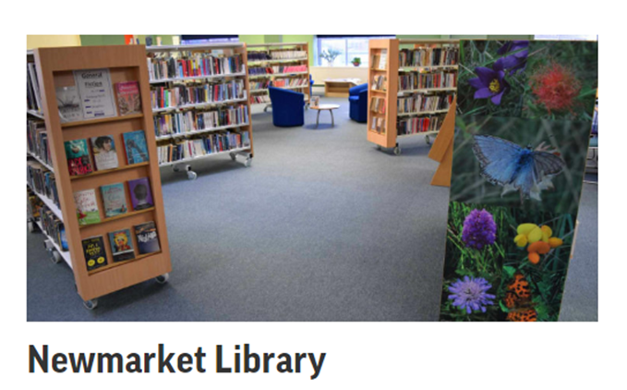

Living Wage & Newmarket Library
Living wage for local jobs in our school
The real Living Wage is the only UK wage rate based on the cost of living. It is voluntarily paid by over 14,000 UK businesses who believe their staff deserve a wage which meets everyday needs - like the weekly shop, or a surprise trip to the dentist.
Our Lady of Walsingham Multi- Academy Trust subscribes to the real Living wage principles.
In Reception Classes, we help all children to register for a library card if they do not have one. We walk the children to the library to introduce them to book loans, take out a book and stay to listen to a story.
Children learn about the joy and importance of using this local library.
We help families by registering them at the library when we visit.

Slide 16

Suffolk Young Carers
There are two types of carers in school that benefit from addition support:
Young carers- a young person, who is caring for or emotionally affected by a family member who has a physical or mental illness, disability or misuses drugs or alcohol.
Sibling carers- a young person who is affected by a brother or sister’s disability, illness or additional need.
School, with family agreement, registers children in school with Suffolk Family Carers. We offer free clubs to registered children in school. Support visits are made by Suffolk Family carers yeam into school and the Suffolk Family Carers run programmes of support that include fun weekend and holiday activities.
We recognise that Young Carers may benefit from extra time to relax and share their concerns with others.

Slide 17
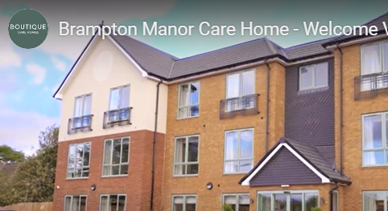
Brampton Manor and Newmarket Day Centre
Our School choir sings at the Newmarket Day Centre and Brampton Manor Care Home.
We have many links with Brampton Manor:
Making and sending Christmas and Easter Cards,
Shared cooking of pancakes with the elderly residents,
Participating in an art competition and judging one another’s art (Winner of Nation Art Competition 2023 in care sector),
Inviting residents to school performances.

Slide 18

Artsmark and Theatre Royal Bury
St Edmunds
St Louis holds an Artsmark Silver Award in recognition its work using drama and art to improve writing in school. Artsmark tell us:
'For its first Artsmark journey, St Louis Catholic Primary has focused successfully on the use of the Arts to support developments in the quality of children’s writing, reading and oracy. You have built links with the Theatre Royal, Door Step Theatre and Tiny Plays, which have engaged the children and developed their writing skills, with UKS2 even having their scripts performed professionally at the Theatre Royal! There has been an increase in performances in school, supported enthusiastically by parents, and children have been involved in costume and set design. Author visits, writing festivals and links with a local artist to create postcard designs are among the ways that you have promoted reading, with good outcomes. Your use of the Primary Knowledge Curriculum has provided a structured approach to skills progression in Art and DT. You have been mindful of the needs of a growing number of vulnerable children, using Drawing and Talking to support mental health. You use Pupil Premium funding to support access for children from low-income families and you have ensured that the instrumental music teaching you now offer is provided for all, through weekly class lessons provided by a music specialist. Your choir continues to be strong, and you have further plans to develop your music offer.

Slide 19


Young Minds and Show Racism the Red Card
Young Minds
Each year, children fund raise for this charity and we focus on mental wellbeing using many resources provided by this organisation. We recognise the importance of good mental health for children and their families.
Young Minds provide young people with tools to look after their mental health. Their website is full of advice and information on what to do if you're struggling with how you feel. They empower parents and adults who work with young people, to be the best support they can be to the young people in their lives. And they give young people the space and confidence to get their voices heard and change the world we live in. Together, we can create a world where no young person feels alone with their mental health.
Show Racism the Red Card
From its launch in 1990 to this day SRtRC continues to utilise the high-profile status of football and football players to help tackle racism in society and has also expanded into other sports and involved other personalities. The majority of the campaign’s work involves the delivery of educational workshops to young people and adults in schools, workplaces and at events held in football stadiums. Across the UK, SRtRC provides educational sessions to more than 50,000 individuals per year, along with hosting the UK’s largest equalities themed School Competition. In 2023, SRtRC has surpassed the landmark milestone of engaging 1 million people in these programmes.
School supports this charity in annual fundraising. We work to teach children that that all racism should be challenged by everyone.

Slide 20

Live Simply Award
The LiveSimply award is an opportunity for Catholic communities – parishes, schools, religious orders and chaplaincies – to answer the call for us to care for our common home and stand in solidarity with our sisters and brothers around the world. The LiveSimply award is a scheme for communities and schools who can show how they have been living:
simply
sustainably with creation
in solidarity with people living in poverty.
The award celebrates what we have already done and inspires us to do more. It helps our school community live, not just more simply, but also more fully.
Our school's actions will impact our global family, our local community and our school community as we reflect the teachings of Laudato Si’ and Catholic Social Teaching along our journey.
We are beginning our journey but recognize that through our wider work, we are already meeting some of the criteria set out to achieve the award.

Slide 21



International Down’s Syndrome Day and Open Door Food Bank
St Louis children are fundraising for a Down’s Syndrome charity because children in school have siblings and other family members with Down’s Syndrome. The money raised is helping Riverwalk to build a hydrotherapy pool for its pupils.
Open Door
Newmarket Open Door is a charity that was formed from a Churches Together initiative when a group of people wanted to do something more about homelessness in the district. One person made the first donation of a five-pound note and Open Door was born. St Louis collect food for Open Door at Harvest Festival time and throughout the year.

Slide 22
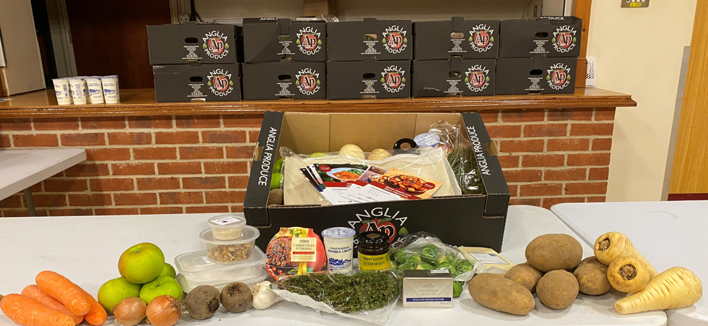
Holiday Activities and Food Programme (HAF)
Our school site is used during the holidays to provide activities and food to families free of charge through the HAF programme. The programme provides healthy meals, enriching activities, and free childcare places to children from low-income families, benefiting their health, wellbeing and learning.
Since 2022, the HAF programme has provided children in school HAF days. The expansion of the programme year-on-year has meant an increasing offer to children.
The programme, though aimed at children in receipt of benefits related free school meals (FSM) is not exclusively for them and Young Carers benefit too. Premier Education deliver the programme on our site through funding from West Suffolk Council. They receive the funding from Government.
In 2024, we partnered with Abbeycroft Outdoor to offer a cooking club to families in receipt of benefits. This includes a cooking session, a shared meal, recope ideas and a box of food to take home for meals over four days.

Slide 23

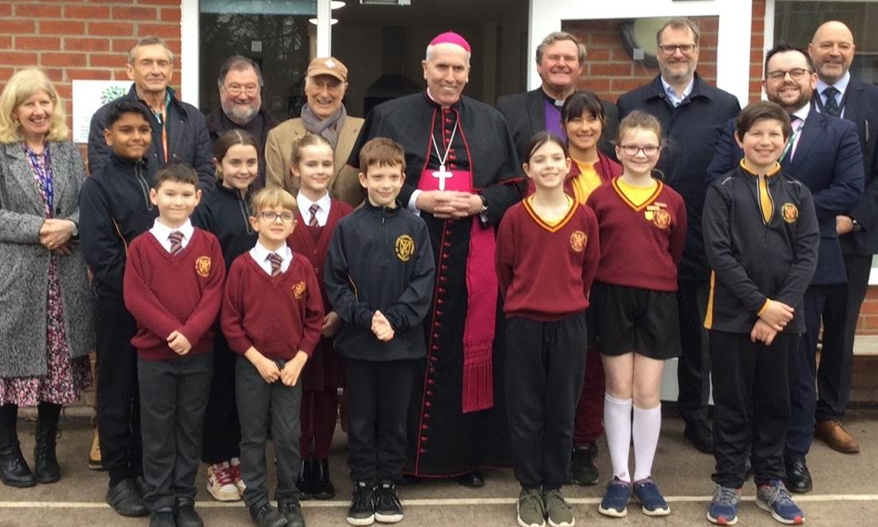

Books to Africa and Mustard Seed Kitchen
From time to time, school sends its redundant books to Africa through this charity. Founded in 2012 the charity’s mission is to promote a culture of ‘readcycling’ and improve the quality of education in Africa, through the collection, processing, shipping and distribution of quality books and educational materials that equip individuals, institutions, and communities to acquire knowledge and achieve their full potential in a globalised world. According to UNESCO, 202 million students who attend school in Sub-Saharan Africa will not be able to read or write properly after finishing school due to lack of quality educational resources. An estimated 770 million across Africa have no access to electricity and 936 million still have no access to the internet! Yet according to CODEP, an estimated 13 million books (7,500 tonnes) go to landfill every year in the UK alone, and the National Wildlife Federation found that approximately 320 million books (160,000 tonnes) are sent to landfill or recycling sites annually in America. Our support helps Books2Africa to continue addressing these challenges.
Through the generosity of the Alive in Faith Catholic Charity and Mr. Bill Gredley, a local benefactor, St Louis has an amazing teaching kitchen that is used to promote health and cooking skills, improve mental health and wellbeing through cooking together and a space to work alongside families, for example, cooking with dads.
We also share this space with Abbeycroft outdoor for Health and Food (HAF) cooking sessions.
Our Mustard Seed Kitchen was opened in 2023 by Bishop Peter.

